Slide 1
Group 01
Under
Guidance :
A Thiyagrajan
BY
Axis11JFSB1111_ Abhishek pol
Axis11JFSB1116 _ Tiwari Neeraj Ramayanprasad
Axis11JFSB1122 _ Aswath T
Axis11JFSB1139 _ Aditya Shamsundar Birajdar

Slide 2
ERegister – BDR (Branch Document Register)

Slide 3
INTRODUCTION
Branch Document Register is maintained to keep a track of all the important [statutory and administrative] documents.
Usually the primary custodian of these documents is the Branch Head.

Slide 4
WHY IT IS IMPLEMENTED
This E-Register will give the flexibility to the Branch head to add various type of documents in the E-register in digital format.
Branch Document Register is maintained to keep a track of all the important Documents

Slide 5
FUNCTIONAL MICROSERVICES
The Brach user can upload a new set of documents
Maker Upload
The Checker can review that the documents which have been uploaded and approve the same.
Checker – Review
The User can search for a particular Documents type as per Region. Circle, Cluster or Sol ID. The user will also be able to view or download the document in PDF format.
View & Download
This the report section in which the user can download various types of Reports.
MIS

Slide 6
ARCHITECTURE
IN THE NEXT SLIDE

Slide 7


Slide 8
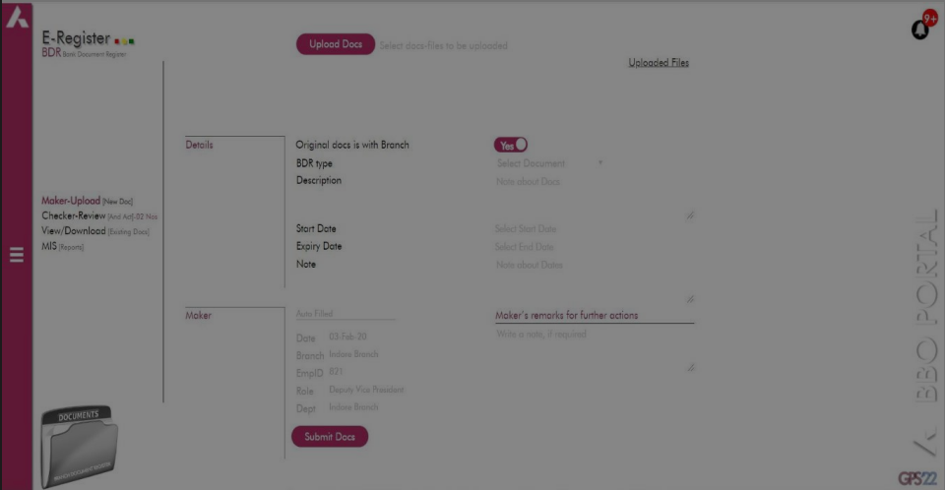

Slide 9
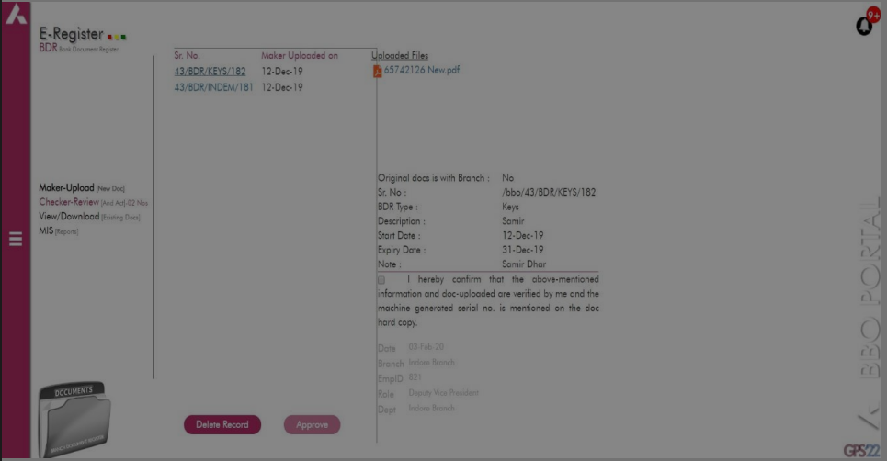

Slide 10
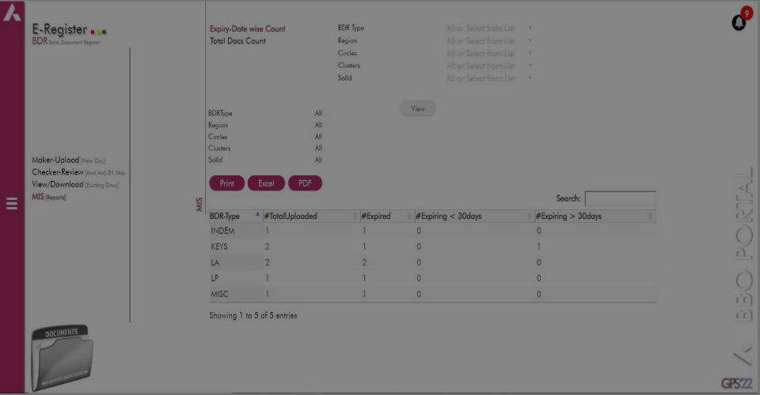

Slide 11
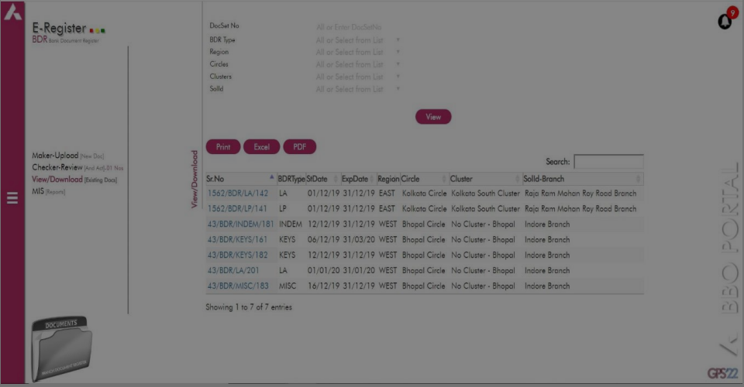

Slide 12




TOOLs USED

Slide 13
Diagram
user can upload
Maker Upload
Checker – Review
Checker can review
View & Download
MIS
User can search for a Documents type
report section

Slide 14
CONCLUSION
flexibility to the Branch head to add various type of documents in the E-register in digital format.

Slide 15
Thank You

